Slide 1


Real-time Observability
on Akamai Connected Cloud
Don’t Let Minor Glitches Become Major Business Disruptions

Slide 2
What is TrafficPeak?
TrafficPeak, on Akamai Connected Cloud, is an observability platform that enables you to ingest, monitor, query, store and analyze massive amounts of data in real time, at 75% less cost than other providers.
With its visualization dashboards, you can uncover and address security issues preemptively, safeguarding your brand’s trust and desirability.
Notes:
Every enterprise consumes a colossal amount data. The question becomes - How can they use that data to anticipate threats, mitigate weaknesses and maintain their customers’ trust? How can that data help reduce security risk, and maintain compliance with regulatory standards? TrafficPeak on Akamai Connected Cloud does just that. The observability platform collects, monitors, retains, correlates and analyzes data from a variety of sources such as SIEM, DNS, DS2, mPulse, CMCD and others, to provide enterprises valuable insights into the inner workings of software applications, user behavior and infrastructure. The insights are visualized in dashboards, showing your customers that needle in a haystack, so that they can preemptively mitigate threatsn and reduce the overall risk of their infrastructure.

Slide 3
Problems TrafficPeak Solves
Colossal amounts of data are expensive to collect & retain.
Current SIEM technology struggles to scale to collect and report on so much data.
Discarding data for budgetary reasons rather than risk considerations. Without historical data it’s tough to find the root cause of events, which elevates the risk of repeat attacks. It also helps uncover how long an attack has been occuring.
Alert fatigue. Can’t find the needle in the haystack.
Real-time visibility into imminent threats is hard, especially when data is displayed on multiple dashboards.
The bigger the data, the slower and more expensive the query process, which lengthens time to mitigation.
Notes:
Here are the problems that TrafficPeak specifically solves:
Data is Expensive - The more data companies collect, retain and analyze, the more expensive it becomes. The expense forces customers to make tradeoffs - discarding data to keep costs down. Yet, when historical data is discarded, it inhibits companies from identifying the root cause of issues, which makes mitigation challenging and increases the risk of repeat attacks. Historical data also shows how long an attack has been happening, a crucial detail in an incident investigation.
Real-Time Visibility is Hard - Today’s IT environment is complex with disparate tools and services, and more application components. It’s tough to bring it all together into one view, with full visibility into the health of applications, services and infrastructure.
Slow query process - Querying is the process of searching data, finding the needle in the haystack to identify a problem, trend or pattern. Querying a large amount of data can be very slow. Imagine sifting through 100 Mount Everests to find one particular kind of rock. It would take an eternity. Yet, you need that rock for a specific purpose now. Ingesting and viewing large amounts of data can also be slow.
Data systems are expensive to Manage and operate - More data = more complexity = harder to manage and operate
Provider lock in - Some providers such as Splunk, require companies to learn a specific language, called SPL (Splunk Processing Language), to query data. Yet another hurdle to overcome if you don’t know the language. Your resources must be trained.
High cost of data retention of other solutions forces companies to make trade offs on how long they keep data and the quality of products they build with that data. We could not build this product before because it cost us too much. There’s an opportunity cost to an organization for the high cost of retaining data. …and it forces companies to retain less and make other undesirable tradeoffs. For example, you want to build an AI enabled SIEM product, building training models to look for anomalies and find things that truly lead to bad outcomes, the less data you have, the less sophisticated the model will be. You can’t build a Black Friday profile for the next Black Friday if you don't have Black Friday data.

Slide 4
What you can achieve with TrafficPeak
Reduce observability costs by 75%. Repurpose your resources on other priority projects.
Ingest as much data as you want and retain it for 15 months or longer.
Prevent incidents. Use historical data to reduce the risk of repeat attacks and discover how long attacks have been happening.
Uncover incidents in real time by viewing alerts, trends and anomalies in your data, and mitigate them before they impact your users.
Find the data you need in seconds, no matter its age. Keep all data hot.
Ingest and combine all data types - DS2, SIEM, mPulse, DNS and CMCD - into one unified dashboard view of the data that matters most.
Integrate Akamai SIEM and other data feeds with one click. No extra provisioning needed.

Slide 5
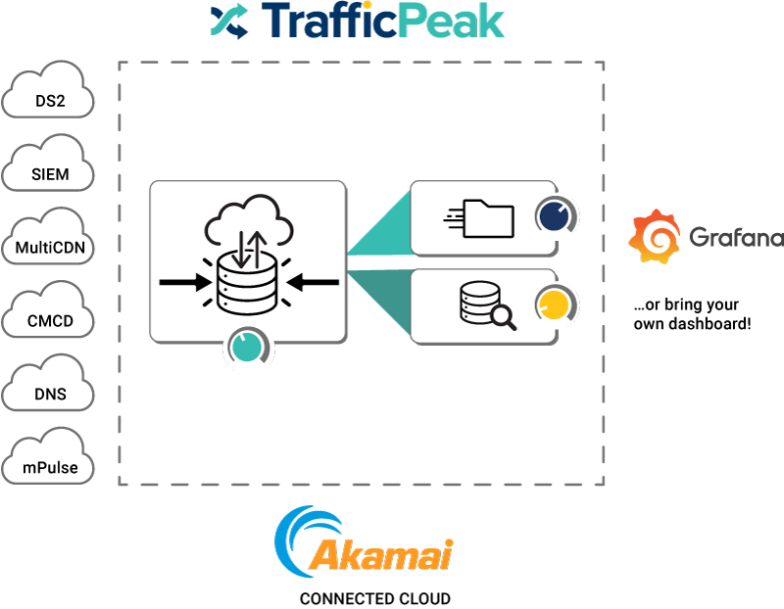
How it Works
Collect, Retain, Query All Time Stamped Data
Ingest live data streams from any device or application
HTTP API
Kafka/Kinesis integration
Prometheus integration
Storage API
In-line transformation and enrichment
SQL-based transforms
Custom dictionaries
Automated indexing of every dimension
Full text search capabilities
Real-time materialized views
No ETL required
Notes:
Akamai is a black box. Now you can see what’s underneath. With TrafficPeak, you have visibility into those services. You can ingest multiple data feeds in, anything that is time stamped. Use our built in Grafana dashboards or bring your own. We can customize dashboards for you based on your needs.

Slide 6
Upsell Grafana Enterprise
Add or Upgrade to Grafana Enterprise for SSO, Role-Based Authentication and more…
SSO
All users have their own login with explicit permissions for what they can and can’t access.
Role-based Authentication and Querying
LDAP integration, restricted query access, automated provisioning and revocation
Automated Emails
Export reporting dashboards as PDFs and send automated emails.
Premium Plug-Ins
Visualize data insights from other providers in one dashboard.
Auditing
Know which changes were made when and by whom. Critical for SOC 2 and ISO 27001 compliance and certification.
Team Sync
Automated synchronization to ensure users end up on the right teams.
Notes:
Key Features for Grafana Enterprise
SSO: Connect your security policies for your systems and employees to one central authority at a fraction of the cost of other observability providers and of buying Grafana Enterprise directly.
Role-based Authentication and Querying: With LDAP integration, partition access and reports by team. Restrict query access to specific teams and users. Automate provisions and revocations of access.
Automated Emails: Export a dashboard as a PDF and send it automatically to executives, board members and other parties to whom you report.
Premium Plug-Ins: Ingest, correlate and visualize data from other observability providers into one TrafficPeak dashboard. View all your data insights in one place.
Auditing: Keep an audit trail to know when changes are made and by whom.
Team Sync: Automated synchronization between teams in Grafana and teams in your authentication provider so users end up on the right team.

Slide 7
Use Cases
Enhanced Proxy detection
It’s common in streaming services where content is licensed for particular regions. By detecting and blocking proxy users, the service ensures that only users from authorized regions can access the content.
Token Authentication for piracy
Token Authentication is widely used in various online services, including content delivery. It can prevent unauthorized sharing of accounts or links. For instance, if a streaming service uses token authentication, even if you share a direct link to a video with someone else, they won't be able to view it unless they also have a valid token.
Longer Data retention for compliance
Industries where service records and other records linked to compliance/regulatory demands must be retained for long periods of time.
Security incident management
Providing a tool for a SOC that improves threat intelligence and shortens the lifecycle from detection to mitigation.
Cross CDN Visibility—Single pane of glass
Normalize logs so you can see across the total of your delivery infrastructure
CDN log ingestion
Historically way too expensive with our competitors.

Slide 8
Splunk vs. TrafficPeak
Splunk
Queries on large data sets time out and are expensive
3 month data retention
More expensive (millions annually)
Can’t search cold storage
Splunk proprietary SPL required
Egress required from Akamai Connected Cloud
Scaling down data may make data unavailable
Splunk doesn’t offer query pools
Proprietary dashboards.
Extremely expensive to ingest CDN logs. People don’t do it.
TrafficPeak
Fast queries, no matter how large the data set, at no extra cost.
15+ month data retention
At least 75% lower total cost of ownership (TCO) than Splunk.
No “hot” and “cold” storage. Can search everything, in sub seconds.
Query in the standard SQL and Spark.
No need to export data. All data stays on Akamai Connected Cloud. No egress costs.
Easily scale down data when demand subsides. Reduces costs.
Query pools allow multiple teams to perform batch queries based on business needs and budget.
Bring your own dashboards.
Notes:
We want to kick off a sales play around Splunk customers. According to a recent study, post the Cisco acquisition, 22% of Splunk customers are seeking new providers for observability. Let’s go after that 22%. Identify Splunk customers. Approach them with these differentiators. Send them the Splunk vs. TrafficPeak whitepaper: https://drive.google.com/drive/folders/1e9IfSg5S-Dlby6g3mvaFmyRts6yEdpNI
Splunk at 100GB a day is $92,000 per year with 1 month retention.So in theory, 10x that for 35TB per month so about 1M$ annually
The top 4 points in orange are the major selling points.

Slide 9
Elastic Cloud vs. TrafficPeak
Elastic
Queries on large data sets time out
Can’t search cold storage
7 days data retention, after that data is moved to cold storage solutions
More expensive (millions annually)
Proprietary ES|QL
Egress required from Akamai Connected Cloud
Scaling up requires everything to scale up.
Elastic doesn’t offer query pools.
Limited dimensionality and cardinality
Managing Elastic clusters is complex and really expensive. Companies need to hire engineers to manage them.
TrafficPeak
Fast queries, no matter how large the data set, at no extra cost.
15+ month data retention
At least 75% lower total cost of ownership (TCO).
No “hot” and “cold” storage. Can search everything, in sub seconds.
Query in the standard SQL and Spark.
No need to export data. All data stays on Akamai Connected Cloud. No egress fees.
Easily scale down data when demand subsides. Reduces costs.
Query pools allow multiple teams to perform batch queries based on business needs and budget.
Bring your own dashboards.
Notes:
Our Patented Microindexing technology on TrafficPeak enables high cardinality.
Time-series data tends to be paired with metadata (sometimes called “tags”) that describes that data. Often that primary time-series data or the metadata is indexed for faster query performance, so that you can quickly find the values that match all of the specified tags.

Slide 10
Datadog vs. TrafficPeak
Datadog
15 days data retention
More expensive (millions annually)
Can’t search cold storage
Datadog proprietary query language required
Egress required from Akamai Connected Cloud
No ingest or query scaling options
Datadog doesn’t offer query pools
Expanded dimensionality and cardinality results in higher costs. Queries involving high cardinality take longer to execute.
TrafficPeak
15+ month data retention
At least 75% lower total cost of ownership (TCO).
No “hot” and “cold” storage. Can search everything, in sub seconds.
Fast queries, no matter how large the data set, at no extra cost.
Query in the standard SQL or Spark.
No need to export data. All data stays on Akamai Connected Cloud. No egress fees.
Easily scale down data when demand subsides. Reduces costs.
Query pools allow multiple teams to perform batch queries based on business needs and budget.
Bring your own dashboards.

Slide 11
New Relic vs. TrafficPeak
New Relic
Queries on large data sets time out
30 days data retention
More expensive (millions annually)
New Relic proprietary query language required
Egress required from Akamai Connected Cloud
No ingest or query scaling options
New Relic doesn’t offer query pools
Proprietary dashboards
TrafficPeak
Fast queries, no matter how large the data set at no extra cost.
15+ month data retention
At least 75% lower total cost of ownership (TCO).
No “hot” and “cold” storage. Can search everything, in sub seconds
Query in standard SQL and Spark
No need to export data. All data stays on Akamai Connected Cloud. No egress fees.
Easily scale down data when demand subsides. Reduces costs
Query pools allow multiple teams to perform batch queries based on business needs and budget
Bring your own dashboards
Notes:
Points to hit on: We are super fast. In a demo we can show how fast we run. Customers can query large data sets and get super fast responses. Other providers time out when they query that amount of data.

Slide 12
Questions

Slide 13
Why Choose TrafficPeak
Collect a colossal amount of data.
Retain it for 15+ months or longer.
Spend at least 75% less than other providers.
Query data within sub seconds, in the standard SQL.
Correlate data from disparate sources into one view, one source of truth.
Bring your own dashboards or use prebuilt Grafana. Open APIs and flexible deployments.
Notes:
Reduce costs: TrafficPeak is a fraction of the cost of other observability platforms and your customers can collect and retain as much data as they want, for at least 15 months. Other providers retain data for only weeks or a few months.
Collect and retain a colossal amount of data: Collect everything. Retain everything. Query everything, in subseconds and in the commonly used SQL or Spark language (whereas Splunk requires users to query in a propietary language) – all at a fraction of the cost of other providers.
See everything: TrafficPeak collects, analyzes, correlates data from disparate tools, systems, and applications. The result - one view, in one dashboard of companies’ most critical data. Your customers can see application, network and infrastructure performance issues, security incidents, user behavior trends and patterns - information that enables them to make business decisions that improve their customer experience and increase their bottom line.
And because they can retain all of their data for months or even years, when there is an incident they can identify the root cause and fix it so it doesn’t happen again.
TrafficPeak is open, meaning your customers can ingest any and all log data, from whichever provider they choose, Akamai and others, into the platform. They can also bring their own Linode cluster or dashboards. This means they can leverage and optimize the investments they have already made.

Slide 14
TrafficPeak Fundamentals
Decoupled storage analytics platform (K8s - LKE).
Data is stored in cloud storage highly compressed.
All data dimensions are indexed (fast lookup).
Scale out query pools to search massive data sets faster
Notes:
Decoupled storage and compute benefits includes no spiralling compute costs as more data is added. Compression and indexing enable super fast query performance.
Multiple groups of people can perform queries at the same time, depending on their needs, and the response time is still in seconds.
A query pool is a repository of queries. They bring value by:
-Reduces costs because customer can provision resources and services based on need. No one size fits all.
-Eliminates resource contention - If one group is putting high demand on a cluster and another group has a small but very important query, both groups can search the same data without interfering with each other.
.

Slide 15
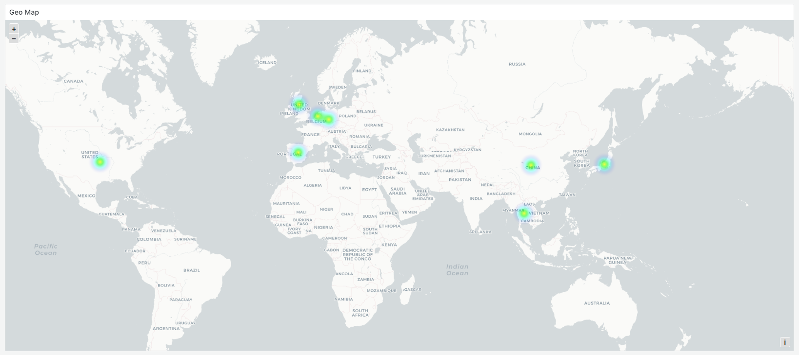
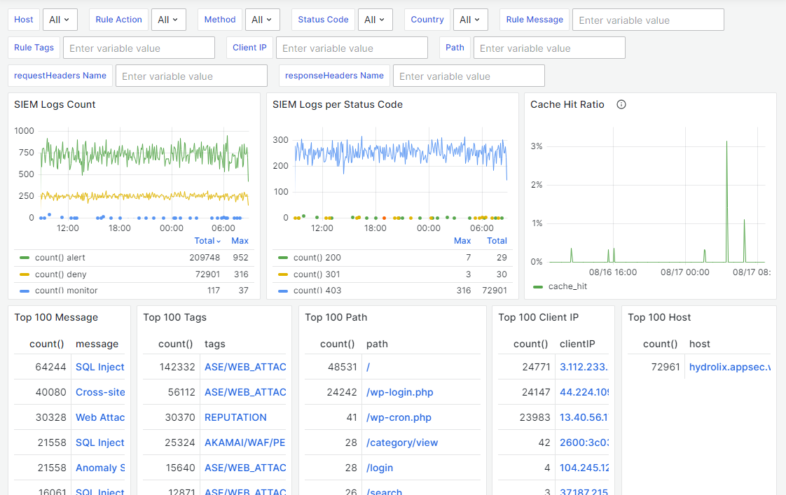
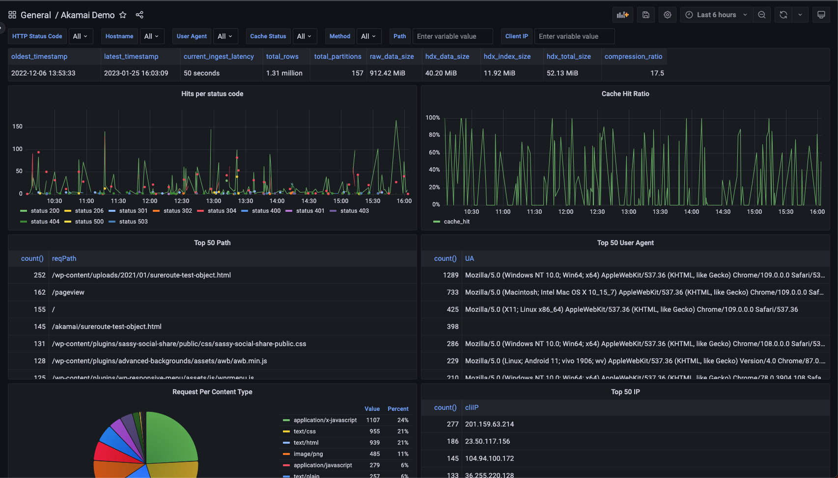
Notes:
TrafficPeak high level overview - observe, gain insights and take actions

Slide 16
Managed Observability Service
Deployed and fully-managed on Akamai Connected Cloud.
Various deployment options, Hosted/BYOL.
Simple, fast, and predictable cost.
Standard dashboards provided out of the box.
Professional services available for customization.
Notes:
TrafficPeak is a fully managed service, which means light lifting from a resource perspective. Plug it in. Turn it on in one click, and let the Hydrolix team manage it, if your customers prefer that route.
BYOL: Bring your own Linode

